Slide 1
Refactoring: what is it?
Definition: Refactoring is a disciplined technique for restructuring an existing body of code, altering its internal structure without changing its external behavior.
Refactoring does not fix bugs, but it may help find bugs by scrutinizing code. It may also reduce the further introduction of bugs by cleaning-up code.
Refactoring does not add new functionality to the system, but it will ease the further adding of new functionality.
It is an essential part of agile software development such as Extreme Programming or incremental development.

Slide 2
Refactoring: when?
Refactoring ought to be done continuously as “bad smells” are encountered during programming.
“Bad smells” or “anti-patterns” are portions of design or code that are characterized as potentially confusing and identifies as refactoring targets.
More importantly, when using iterative development, a major refactoring stage should precede the beginning of the development of a new build. This will remove slight design problems and ease the addition of further functionality.
In this case, refactoring counterbalances the productivity-driven software development practices implied by agile incremental software development.

Slide 3
Refactoring: why?
Refactoring is usually done to:
Improve quality
improve design quality
improve maintainability
improve extensibility
Improve sustainability of development
requires proper testing, so improves testability
helps to find bugs
Improve productivity
improve code readability & comprehensibility
simplify code structure

Slide 4
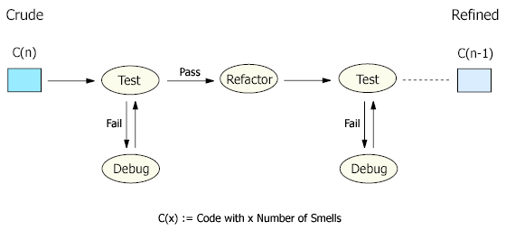
Refactoring: how?
Each refactoring is implemented as a small behavior-preserving transformation.
Behavior-preservation is achieved through pre- and post-transformation testing.
Refactoring process: test-refactor-test

Slide 5
Refactoring: drawbacks
Cost Overhead: Refactoring is an add-on activity and therefore will incur extra cost in form of time, effort, and resource allocation, especially if elaborated design and code documentation is maintained. However, when done sparingly and only on key issues, its benefits are greater than its overhead. Automated documentation tools, code browsing tools, refactoring tools and testing tools will also diminish the refactoring overhead.
Requires Expertise: Refactoring requires some expertise and experience and considerable effort in going through the process, especially if proper testing is involved. However, this overhead can be minimized by using refactoring tools and automated testing such as with a unit testing framework.

Slide 6
Refactoring: examples
Consolidate Conditional Expression: You have a sequence of conditional tests with the same result. Refactor by combining them into a single conditional expression and extract it.
double disabilityAmount() {
if (_seniority < 2) return 0;
if (_monthsDisabled > 12) return 0;
if (_isPartTime) return 0;
// compute the disability amount
double disabilityAmount() {
if (isNotEligibleForDisability()) return 0;
// compute the disability amount

Slide 7
Refactoring: examples
Consolidate Duplicate Conditional Fragments: The same fragment of code is in all branches of a conditional expression. Refactor by moving it outside of the expression.
if (isSpecialDeal()) {
total = price * 0.95;
send();
} else {
total = price * 0.98;
send();
}
if (isSpecialDeal())
total = price * 0.95;
else
total = price * 0.98;
send();

Slide 8
Refactoring: examples
Rename Method: The name of a method does not reveal its purpose. Refactor it by changing the name of the method.
int getInvCdtLmt(){
…
}
int getInvoiceableCreditLimit(){
…
}

Slide 9
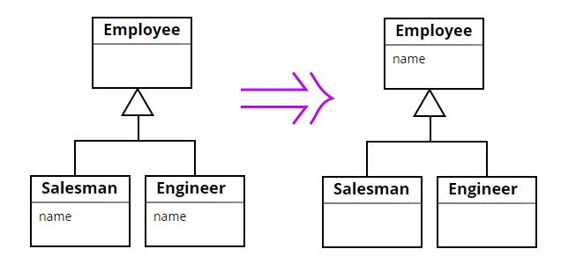
Refactoring: examples
Pull Up Field: Two subclasses have the same field. Refactor it by moving the field to the superclass.

Slide 10
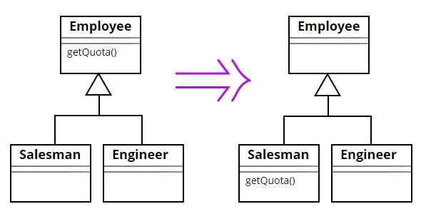
Refactoring: examples
Push Down Method: Behavior on a superclass is relevant only for some of its subclasses. Refactor it by moving it to those subclasses.

Slide 11
Refactoring: practice
Some refactorings are controversial.
Some refactorings are arguably not improving code quality.
Some refactorings can in fact be counter-productive when applied blindly, especially in iterative development, where design is evolving.
Have your team adopt a set of refactorings to be applied, and make sure that refactorings are applied in a productive manner.
Apply in combination with the application of design patterns.
Use refactoring tools to automate changes, e.g. Eclipse refactoring, and JUnit testing framework.

Slide 12
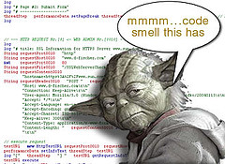
Signs you should refactor
code is duplicated
a routine is too long
a loop is too long or deeply nested
a class has poor cohesion
a class uses too much coupling
inconsistent level of abstraction
too many parameters
to compartmentalize changes (change one place → must change others)
to modify an inheritance hierarchy in parallel
to group related data into a class
a "middle man" object doesn't do much
poor encapsulation of data that should be private
a weak subclass doesn't use its inherited functionality
a class contains unused code

Slide 13
Code "smells"
Duplicated Code
Long Method
Large Class
Long Parameter List
Divergent Change
Switch Statements
Parallel Inheritance Hierarchies
Lazy Class
Speculative Generality
Temporary Field
Message Chains
Middle Man
Alternative Classes with Different Interfaces
Incomplete Library Class
Data Class
Refused Bequest
(subclass doesn't use inherited members much)
Comments

Slide 14
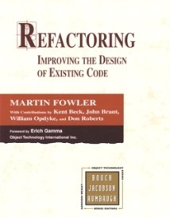
Some types of refactoring
refactoring to fit design patterns
renaming (methods, variables)
extracting code into a method or module
splitting one method into several to improve cohesion and readability
changing method signatures
performance optimization
moving statements that semantically belong together near each other
naming (extracting) "magic" constants
exchanging idioms that are risky with safer alternatives
clarifying a statement that has evolved over time or is unclear
See also http://www.refactoring.org/catalog/

Slide 15
Refactoring patterns
Composing Methods
Extract Method
Inline Method; Inline Temp
Replace Temp with Query
Introduce Explaining Variable
Split Temporary Variable
Remove Assignments to Parameters
Replace Method with Method Object
Substitute Algorithm
Moving Features Between Objects
Move Method; Move Field
Extract Class
Inline Class
Hide Delegate
Remove Middleman
Introduce Foreign Method
Introduce Local Extension
Organizing Data
Self-encapsulate Field
Replace Data Value with Object
Change Value to Reference; Change Reference to Value
Replace Array with Object
Duplicate Observed Data
Change Unidirectional Association to Bidirectional
Change Bidirectional Association to to Unidirectional
Simplifying Conditional Expressions
Decompose Conditional
Consolidate Conditional Expression
Consolidate Duplicate Conditional Fragments
Remove Control Flag
Replace Nested Conditional with Guard Clauses
Replace Conditional with Polymorphism
Introduce Null Object
Introduce Assertion
Making Method Calls Simpler
Rename Method
Add/Remove Parameter
Separate Query from Modifier
Parameterize Method
Replace Parameter with Explicit Methods
Preserve Whole Object
Replace Parameter with Method
Introduce Parameter Object
Remove Setting Method
Hide Method
Replace Constructor with Factory Method
Encapsulate Downcast
Replace Error Code with Exception
Replace Exception with Test
Dealing with Generalization
Pull Up Field; Method; Constructor Body
Push Down Method; Push Down Field
Extract Subclass; Extract Superclass; Interface
Collapse Hierarchy
Form Template Method
Replace Inheritance with Delegation (or vice versa)
Big Refactorings
Nature of the Game
Tease Apart Inheritance
Convert Procedural Design to Objects
Separate Domain from Presentation
Extract Hierarchy

